Slide 1
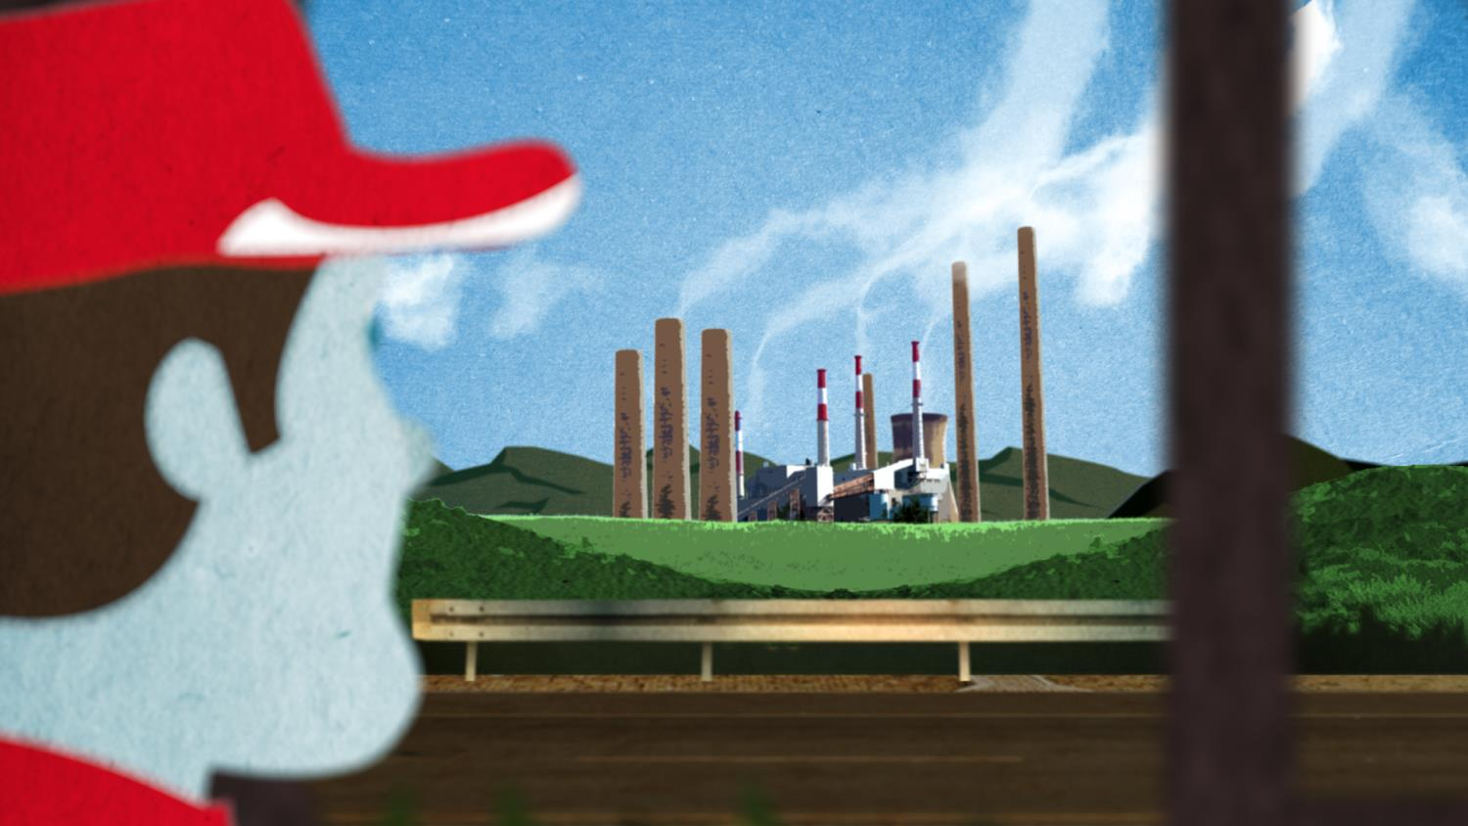

CLIMATE AMBASSADOR TRAINING
Module 4 – ENGAGING SUPPLIERS
ini partnership with

Slide 2

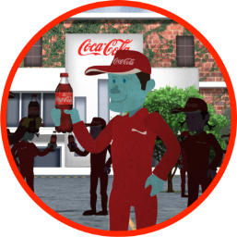
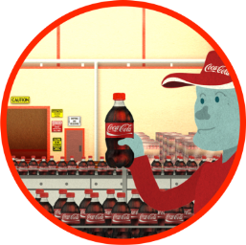


TRAINING AGENDA: LEADERS
CLIMATE AMBASSADORS
MODULE 1: INTRODUCTION
MODULE 2: BUSINESS CASE
MODULE 3:
IN ACTION
MODULE 4:
ENGAGEMENT
• WHY WE ARE HERE
• GOALS • TRAINING OBJ. • DISCUSSION
• BUSINESS STRATEGY
• REVENUE • RISK
• REPUTATION
ME, WE, WORLD
• STRATEGIC FRAME
• KEY INTERVENTIONS
• INGREDIENTS
• PACKAGING
• MANUFACTURING
• DISTRIBUTION
• REFRIGERATION
STEPS FOR ENGAGING SUPPLIERS
Notes:
The Climate Ambassador training was developed to train experts in our system to help
Introduction: The 2020 Climate Target and the Role of Climate Ambassadors
STRATEGIC BACKGROUND
The Coca-Cola Company is expanding its carbon targets from manufacturing to encompass additional scope 3 elements across the broader supply/value chain, including upstream (ingredients and packaging) and downstream (distribution and refrigeration). The Company has adopted a new target to reduce the carbon footprint of the “drink in your hand” over this decade (2010-2020). This shift will require an additional set of capabilities to deliver on the new targets. For example, our employees will need to reach outside of their sphere of business control to partner with suppliers on emissions reductions projects –like reducing fertilizer use in our corn/sugar/citrus supply, reducing packaging, reducing fuel intensity in distribution, etc.
As part of building a new set of capabilities, the World Wildlife Fund partnered with The Coca-Cola Company to train a corps of Coca-Cola Climate Ambassadors as internal spokespeople and champions of climate innovation along the supply chain.

Slide 3


ENGAGING SUPPLIERS
Initiating Conversations Internally
Sharing Information
Identifying Opportunity
Partnering
Setting Goals
Implementation: Testing, Managing + Measuring Results
Notes:
We’ve learned about the why, the business case, and some ideas for what we can do. In most of the cases that you’ve heard about today involve relationships with suppliers.
From InBev’s shared logistics where InBev worked with its suppliers to develop joint shipping logistics and take advantage of every mile instead of sending trucks back empty.
To Stonyfield Farm working with its suppliers to develop low-density plastic.
To Tropicana collaborating with it’s orange suppliers to improve fertilization practices.
But how they do it is the question.
And to cases we haven’t discussed today like SuperValu – a large grocery chain that also supplies to 4000 retail outlets – working with its grape suppliers to reduce their packaging for shipping.
These solutions require collaboration and, like any successful solutions, require smart strategy and some behavioral change. Unlike climate action in energy efficiency or manufacturing areas, where Coca-Cola is used to working, most of these practices are outside of Coca-Cola’s sphere of control. Achieving results requires that Coca-Cola executives and employees work beyond their sphere of control to inform, persuade, influence and engage suppliers in strategic business and behavioral changes. To make change happen, we need to become influencers – broadening our sphere of influence.
We must learn how to work in alignment with other internal departments, with our suppliers, with community partners. This module talks about those relationships and also give us a guide to get started.
So how do you start to work outside of your sphere of control ~ within your sphere of influence?
Let’s look at a case where suppliers took on big change and consider how you can work internally, with suppliers and new partners

Slide 4
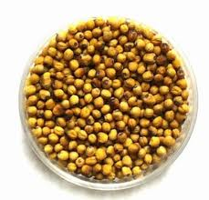


CASE: UNILEVER AND CARGILL
JOINTLY ACTING ON OPPORTUNITIES
GREENING YOUR SUPPLY
Unilever partnered with its supplier Cargill (Refined Oils in Europe) to build a sustainable supply of oilseed rape.
Notes:
An example from other companies: Unilever plans to double the size of its business while halving the environmental impact of its products by 2020. To reach its goals, Unilever must partner with suppliers to, among other things, ensure good soil and fertilizer management. They increased their sustainable sourcing from 24% to 10%.
In this case, Unilever partnered with its supplier Cargill (Refined Oils in Europe) to build a sustainable supply of oilseed rape. (Oilseed rape is an ingredient in dressings and spreads like mayonnaise.)
How they did it:
(Share Information) Unilever came to Cargill to discuss opportunity. They wanted to cover 5% of their supply.
(Identified Opportunity): Cargill (Unilever’s supplier) mapped out the Unilever rapeseed supply chain from farm to end product in the Salzgitter region
(Partnered): Unilever and Cargill prepared the necessary sustainability criteria.
(Set Goals): Sustainability criteria include energy use and soil management. Full criteria are available in case.
(Manage): Cargill partnered with farmer cooperative to perform pilot study. Farmers are interested in this study because their end customer wants a sustainable product.
Cargill selected farmers for pilot testing:
Different size and different soil quality
Communication via farmer cooperative
RESULTS
The companies were able to jointly deliver a sustainable supply of rapeseed oil in 2012.
RELEVANCE TO COCA-COLA
By partnering with suppliers, Coca-Cola bottlers can green their supply chains. Outreach, planning, and communications to suppliers are the first step in these projects.
How can suppliers work with suppliers? We talked about Coca-Cola fertilizer work with Kellogg, Smithfield, etc. How else?
Exchange information
Exchange resources (trash to treasure)
Increase efficiency within the supply chain

Slide 5
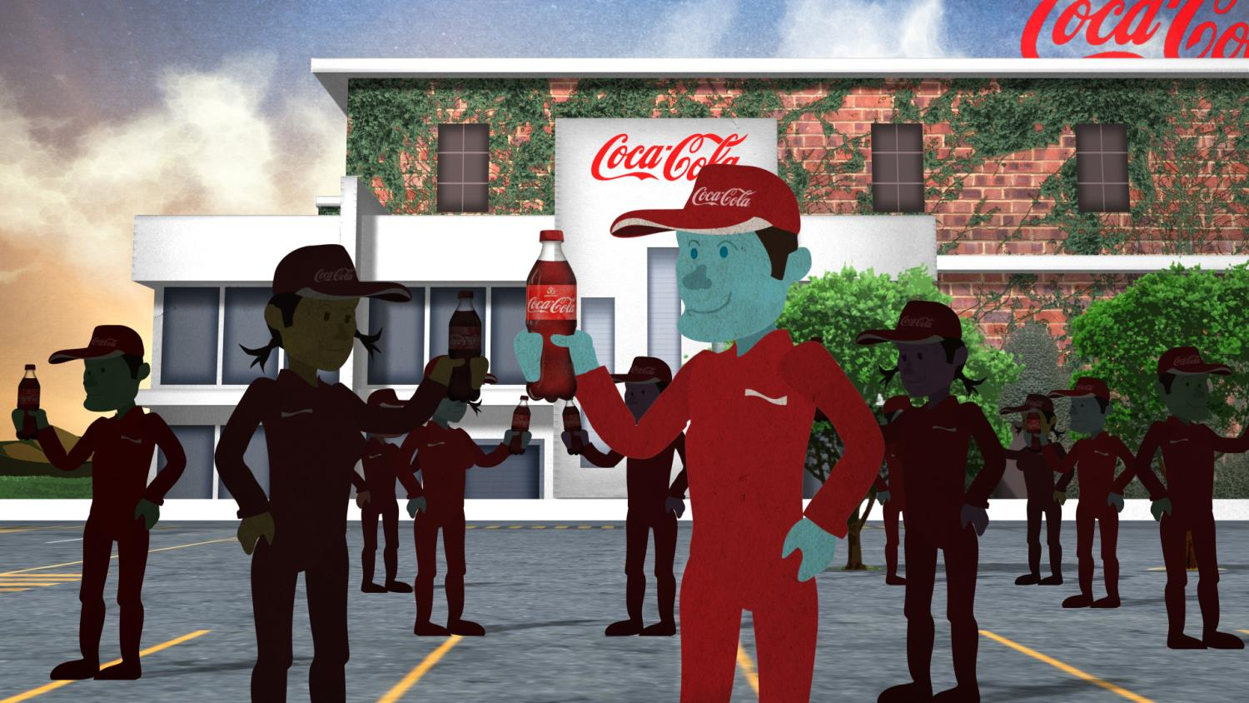
COLLABORATING INTERNALLY (AT THE CORE OF SUPPLIER RELATIONSHIPS)
Notes:
The commonality that we’ve discussed today that the sustainability and climate professionals work very closely with procurement, fleet, or other internal departments to understand opportunities (that they might not have seen before), to communicate their goals – and to jointly explore opportunities with their suppliers and partners.
First things first: Bringing the message to your own colleagues is an important way forward.
How can you leave here ready to do that?
For Coca-Cola to act along the value chain, we must learn how to work in alignment with other internal departments.
DISCUSSION
Before even understanding what your priorities are, who in your organization should you start educating now?
Ingredients
Packaging
Manufacturing
Distribution
Refrigeration
What are your ideas for reaching them?
How do you take these messages to our staff who has the most contact with suppliers?
How do we train staff at your organization so they take the right messages to suppliers?
What are the steps?

Slide 6
ENGAGING SUPPLIERS
Initiating Conversations Internally
Sharing Information
Identifying Opportunity
Partnering
Setting Goals
Implementation: Testing, Managing + Measuring Results

Slide 7
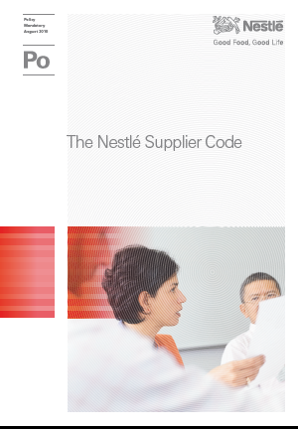

APPROACH: PUTTING SUSTAINABILTY AT THE CORE OF SUPPLIER RELATIONSHIPS
Nestle Agricultural Services Teams
273,808
Farmers trained through capacity-building programs in 2012.
Notes:
As we educate our own staff, how can Coca-Cola work with suppliers?
Putting sustainability at the core of supplier relationships can help create competitive and cost advantages.
A few interesting examples to share about structuring the relationship.
Nestle has a supplier code – like many of its competitors – but has a commitment to regularly approach vendors with good ideas.
It also invests significantly in capacity building for its supply chain. For example, in 2012, Nestle trained 273,808 farmers on business and better farming practice.
Danone has all of its vendors sign carbon pacts with all its suppliers that asks them to come up with good ideas for carbon reduction. The commitment is to work together to drive down carbon emissions for our products. Danone shares its plan to reduce and they agree to work together. There are no legally binding mechanisms but suppliers work harder to find reduction opportunities – to make Danone (their customer) meet their goal. Because of the agreement, Danone’s expectation for continuous innovation is front and center in their business relationship.
DISCUSSION:
How many of you are working with your procurement department regularly on vendor relationships?
How?
What’s working and what’s not?
And with your customer departments?
What are some examples of working with suppliers? To start:
Share information
Help measure (steps)
Help identify opportunities
Help act on those opportunities, like reducing emissions and be more competitive, adopting a supply target, or any of the other practices discussed in Module 3.

Slide 8
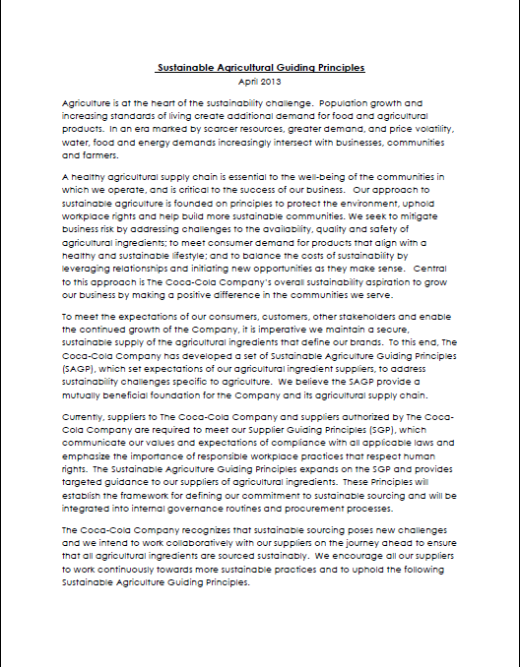

HOW MANY SUPPLIERS KNOW ABOUT? ENVIRONMENTAL GUIDELINES
EXAMPLE
Coca-Cola Sustainable Agriculture Guiding Principles
Notes:
Before I ask how many of your suppliers know about your environmental guidelines in sustainable agriculture (as an example), I’ll ask:
How many of you know about the Sustainable Agriculture Guiding Principles?
How many of you know how to get a copy?

Slide 9
ENGAGING SUPPLIERS
Initiating Conversations Internally
Sharing Information
Identifying Opportunity
Partnering
Setting Goals
Implementation: Testing, Managing + Measuring Results

Slide 10
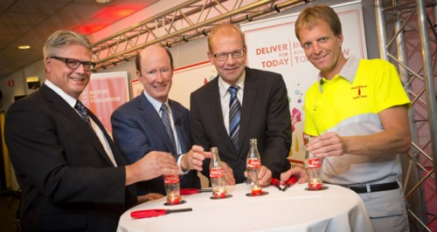
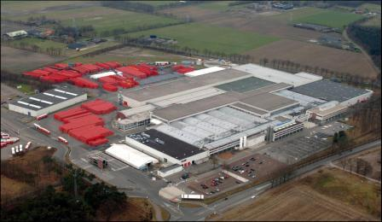
LOOKING OUTSIDE OF SPHERE OF CONTROL TO
IDENTIFY BIG OPPORTUNITIES
Notes:
There is opportunity all around. As we reviewed earlier in the Coca-Cola in Dongen partnership with Ardagh Packaging’s nearby facility, looking outside of your sphere of control will help you identify opportunities.

Slide 11
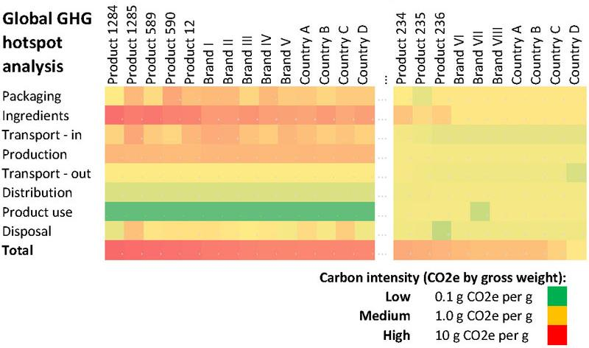
CASE: PARTNERING WITH NONPROFITS FOR EXPERTISE
MAPPING TO SET GOALS
SNACKS
BEVERAGES
MEASURING
Tropicana and Columbia University's Earth Institute partner on Global Hotspot Analysis
Notes:
An example of setting goals is seen in the case from Tropicana. One of the most confusing parts of getting started is knowing where to focus. Measuring is an important first step. There are experts to help – consultants, nonprofits, and your own suppliers. In Tropicana’s case, they partnered with Columbia University's Earth Institute partner on Global Hotspot Analysis.
RELEVANCE TO COCA-COLA
You’ll have the Carbon Achievements Planner to help you gauge numerical opportunities.
How will you identify which suppliers are actually interested in moving along with you?
You can partner with nonprofits and experts to exchange information about where opportunities are, exchange resources (trash to treasure), collaborate.

Slide 12
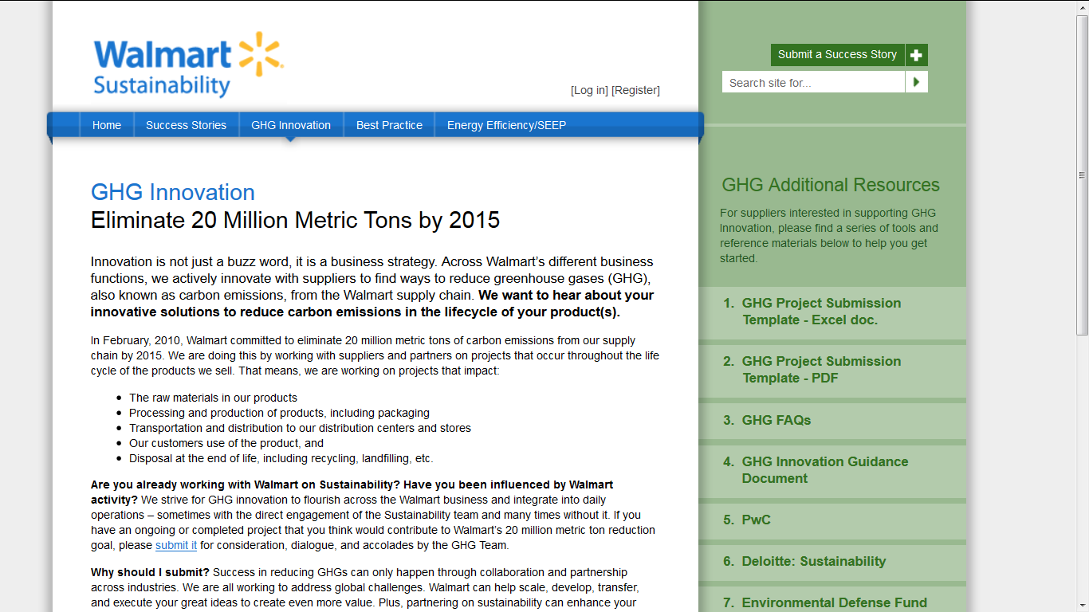
OUR CUSTOMERS PUTTING SUSTAINABILTY AT THE CORE OF SUPPLIER RELATIONSHIPS
Notes:
As discussed in Module 2, in February, 2010, Walmart committed to eliminate 20 million metric tons of carbon emissions from their supply chain by 2015.
Walmart is doing this by working with suppliers and partners on projects that occur throughout the life cycle of the products they sell. That means, Walmart is working on projects that impact:
The raw materials in products
Processing and production of products, including packaging
Transportation and distribution to distribution centers and stores
Customer use of the product, and
Disposal at the end of life, including recycling, landfilling, etc.
Walmart puts public invitation out to its suppliers to engage with Walmart, they stage pilots with suppliers on each of their issues, and the provide all suppliers with tools and guidance to work on the issues without direct piloting. An example is the Walmart Fertilization Optimization Kit
Additional Information
Walmart started out requiring their suppliers to answer questions about environmental practice. It started as an assessment exercise. At a point, they picked a group of suppliers and went through a full implementation exercise – changing their practices. More recently, they’re picking topics – and taking those on directly.
How relevant do you find Walmart’s work to yours?

Slide 13

CASE: FEMSA-BRAZIL
TRAINING SUPPLIERS TO FIND OPPORTUNITY
HOW?
FEMSA in Brazil sponsored a workshop to train over 100 suppliers to carry out carbon inventories.
Notes:
Coca-Cola does a good job of working with suppliers on carbon disclosure (CDP Initiative).
•Coca-Cola’s supplier response rate is above the average supplier response rate of all members in the CDP Information Request
•Coca-Cola’s suppliers scored above the global average in both disclosure and performance
•Higher percentage of Coca-Cola’s suppliers set emission targets as compared to the average for suppliers of all other members
•Coca-Cola’s suppliers are more evolved in risk and opportunity identification than the average for suppliers of other members
And Groups are taking work into their own hands. For example, FEMSA in Brazil sponsored a workshop to train over 100 suppliers to carry out carbon inventories.
WHAT IS IT
The program's objective is to seek the involvement of suppliers to Coke and other companies, especially those with potentially large environmental footprint (emission) in the formulation and publication of inventories of greenhouse gases. In short, the objective is to sensitize and train 100+suppliers of participating member companies in carrying out their inventories, monitoring emissions and sharing successful carbon emission reduction case studies.
BENEFITS
Shared the cost of training with other companies and increase the number of participants (outreach). Create awareness of emission by teaching one how to calculate emissions. Engage supplier in the magnitude of their impacts and how emission reduction will be realized within the value chain. Show that CO2 emissions = waste.

Slide 14
ENGAGING SUPPLIERS
Initiating Conversations Internally
Sharing Information
Identifying Opportunity
Partnering
Setting Goals
Implementation: Testing, Managing + Measuring Results

Slide 15
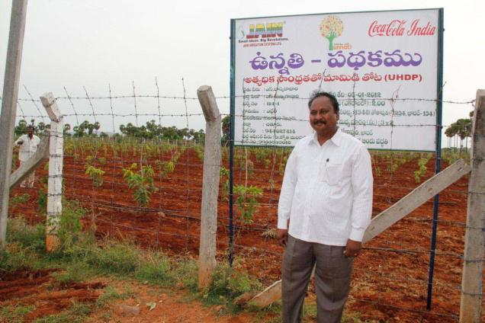
CASE: COCA-COLA INDIA and JAIN IRRIGATION
BUILDING A BETTER MANGO SUPPLY
CO-INVESTING IN 200 DEMO FARMS TO DOUBLE MANGO PRODUCTION
The initiative provides field‐based training to Indian mango farmers on modern, sustainable agriculture and the adoption of the Ultra‐High Density Plantation (UHDP) technique.
Notes:
An example of collaborating with suppliers to build a better mango supply:
PROJECT
Project Unnati is a partnership between Coca-Cola India and Jain Irrigation, Coca-Cola’s largest mango supplier in India. Jain supplies almost 60% of their mango pulp to Coca-Cola. The initiative provides field‐based training to Indian mango farmers on modern, sustainable agriculture and the adoption of the Ultra‐High Density Plantation (UHDP) technique. Through Coca-these efforts are expected to double mango yields for over 50,000 farmers, thereby increasing farmer incomes and the availability of an important commodity in Coca-Cola’s agricultural ingredient supply chain. Each company invested 1million dollars in the initiative.
Goals and Objectives:
􀁸 Encourage sustainable, modern agricultural practices among Indian mango farmers, such as grafting of commercial mango varieties and special pruning, fertilization, and drip irrigation techniques
􀁸 Establish 300 acres of UHDP demonstration plots
􀁸 Double per acre mango yields
􀁸 Increase income of more than 50,000 farmers over a 5‐year period through training programs
􀁸 Decrease the quantity of water used per kilo of mango produced

Slide 16
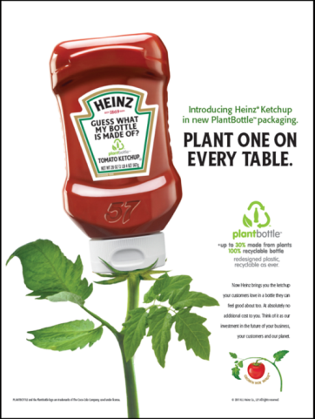




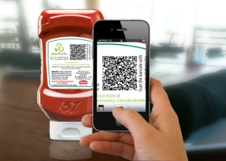


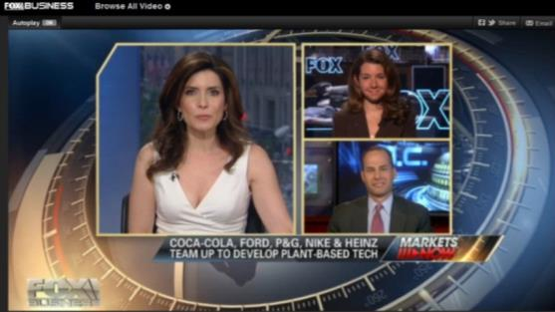
OPENS
OPPORTUNITY FOR COLLABORATION
technology collaborative
Notes:
Partnerships for driving change along the supply chain take all forms. For packaging, Coca-Cola formed a sustainable innovations collaborative to support new technologies in an effort to evolve today's material that is partially made from plants to a solution made entirely from plants. Member companies are making a commitment to champion and support research, expand knowledge and accelerate technology development to enable commercially viable, more sustainably sourced, 100% plant-based PET plastic while reducing the use of fossil fuels.
By leveraging the research and development efforts of the founding companies, the PET Technology Collaborative (PTC)
is taking the lead to affect positive change across multiple industries. PTC members are committed to researching and developing commercial solutions for PET plastic made entirely from plants and will aim to drive the development of common methodologies and standards for the use of plant-based plastic including life cycle analyses and universal terminology.

Slide 17

CASE: COCA-COLA and TICO FRUIT
PILOTING - SUSTAINABLE ORANGES
WORKING TOGETHER ON PILOTS
Coca-Cola financially supported a research program in Costa Rica to reduce fertilizer use in orange groves at Earth University, jointly exploring whether this strategy could work for Tico Fruit the science commercially. All signs are positive
Notes:
An example of collaborating with experts and suppliers on research projects to jointly identify opportunities:
PROJECT
Tico Fruit, a supplier of orange juice to Coca-Cola, is experimenting with applying a natural nitrogen fixer to reduce unnecessary fertilizer use in their orange groves, a practice that both reduces costs of farming AND reduces greenhouse gas emissions, as well as protects watersheds.
RESULTS
Tico Fruit also has a large scale projects to create compost that can fertilize their groves AND minimize their costs of waste removal of used fruit. The results to date have indicated that both of these practices have strong applications for commercial operations, including lower cost of fertilizer inputs.
RELEVANCE TO COCA-COLA
Tico Fruit is a significant supplier of oranges to Coca-Cola. By reducing fertilizer use at Tico Fruit groves, Coca-Cola reduces its footprint.

Slide 18

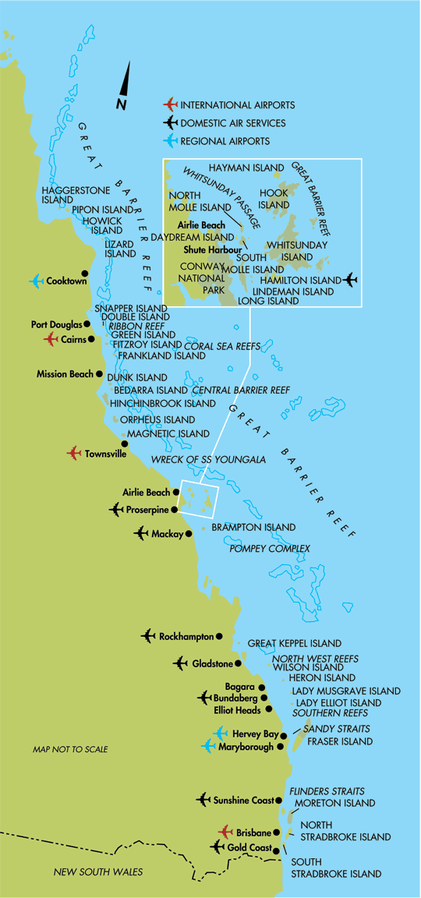
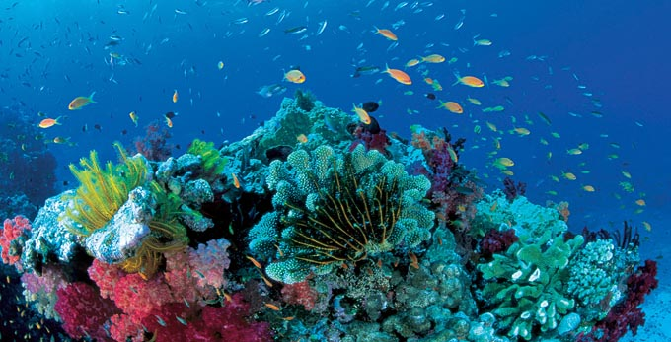
Notes:
Now we’ll look at an example of public private partnership in Australia through Bonsucro. This partnership started to protect the Great Barrier Reef – but, in the end, improved farming practice, was good for farmers, good for the country, and good for Coca-Cola.

Slide 19
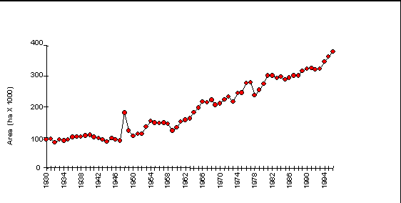
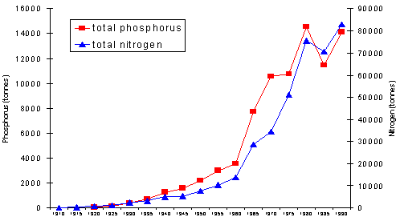
Queensland area used for sugar cane cultivation (1930-1996)
Nitrogen and Phosphorus fertilizer in Great Barrier Reef Catchment
Notes:
The Queensland Watershed feeds directly into the Great Barrier Reef. You can see in the graphs that over the last century, the area under sugar cane production has increased substantially. In line with additional cultivation, nitrogen and phosphorus fertilizers have been used and have increased dramatically in the catchment.

Slide 20

IMPROVVING PRACTICES TO PROTECT THE GREAT BARRIER REEF
Notes:
When we think of threats to the Great Barrier Reef, outdated land management practices are probably not the first things that come to mind. More likely you envision dynamic and diverse coral life. Yet runoff from sugarcane and other farms near the coast can have a severe impact. Sediment can smother corals, chemical herbicides and pesticides poison reef species, and fertilizers destabilize nutrient levels resulting in algal blooms that form a breeding ground for the devastating coral-eating crown-of-thorns starfish.

Slide 21
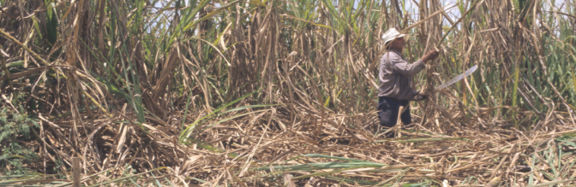
“We live on the doorstep of the reef, and
we don’t want to harm it.”
“When we put nutrients into the ground, we want to get the most out of them,”
“We can’t afford to have chemicals leave our property.”
Notes:
While overuse of fertilizer from agriculture is a major driver of this damage, no farmer wants it to happen. The damage is an externality of their livelihood.
There are better farming practices and technologies that can reduce these impacts, some of which result in lower costs, but the farmers lacked training. And some practices required new methods and machinery. The thousands of cane-growing families in the region often struggle to make a living and few could afford to invest in that machinery without the certainty of an immediate return.

Slide 22



Notes:
That’s where Project Catalyst comes in. A partnership between WWF, natural resource management groups Reef Catchments and Dry Tropics and Terrain, The Coca-Cola Foundation, the Australian government and local sugarcane farmers, the project supports farmers to trial, monitor and share information and knowledge on cutting-edge practices to improve farm management, water quality, landscape health, farm economic viability and social well-being of rural communities. Financial assistance to farmers in the reef catchment areas cover up to half the cost of switching to more sustainable farming practices. To minimize risk of changing established practices, Project Catalyst partners support farmers in testing practices, ranging from new cultivation strategies to equipment modifications.

Slide 23
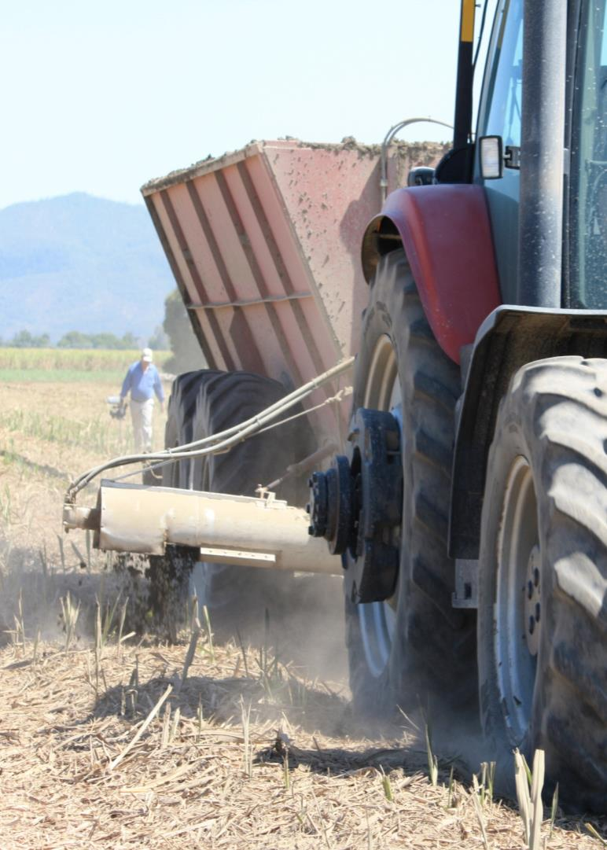
IMPROVING PRACTICES VIA PARTNERSHIPS
We work with sugarcane farmers along Australia’s Queensland coast to improve farming practices and protect the Great Barrier Reef.
Through Project Catalyst, farmers pilot innovative new farming practices using new technologies, improved planning and reduced chemical inputs.
To date, 78 growers who farm more than 50,000 acres have improved the quality of more than 100 billion liters of runoff water flowing into the Reef.
© Project Catalyst
Notes:
When the project began in 2009, 19 farmers were involved; there are now 78 growers who farm on more than 50,000 hectares.
One farmer was able to trial an automated controller to adjust the height of the cutting blade on the harvester. Sugarcane harvesting machines cut the plant at ground level; a new stalk (or ratoon) then grows. The cutting height is crucial – cutting too deep leads to slower germination and less production. As well as giving a lower yield, smaller plants absorb less of the fertilizer in the soil, leading to increased runoff. Less growth also means less crop residue to provide mulch for the next ratoon – which in turn means more chemical herbicides, fertilizers and watering. Usually the driver controls the cutter height but, soil variability makes this difficult The automated cutter uses five sonar sensors to make sure the blade is always 15mm above ground level, no matter what the ground height is. This should encourage healthy regrowth, reducing the need for chemical inputs.

Slide 24


It improves efficiency and the buyers insist on it
It enhances our corporate reputation and our consumers expect it
It’s the industry standard for a secure and sustainable future
Sugar
Producers
Corporate Buyers
Notes:
Project Catalyst also positions farmers to be aligned with the Bonsucro certification process.
RELEVANCE TO COCA-COLA
By committing to Bonsucro certified sugar, Coca-Cola sends meaningful market messages to sugar cane producers around the world that there is a marketplace for their products and that they can be rewarded for committing to sustainable practices. It’s Project Catalyst that enables the farmers to safely make the transition from traditional practices to these new best practices.
WWF and nonprofit partners brought a set of capabilities to the table that Coca-Cola needs, but does not have internally.

Slide 25
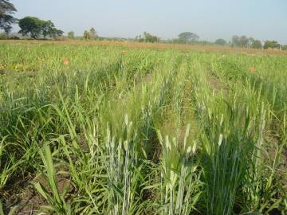
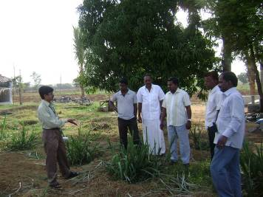
PARTNERING FOR BETTER MANAGEMENT PRACTICES
Issues in India:
Water table depleting year after year (1500-3000 litres/1 kg of cane)
Improper cultivation practices
Imbalanced nutrient management and other practices like mono cropping often result in low productivity
Unpredictable climatic aberrations
WWF-India Thirsty Crops work
21 BMPs
Implemented by farmer groups
Results include improved input use (water and agrochemicals) increased POL and sucrose recovery
WWF-International and ICRISAT partnership
SSI may save between 40 - 80% of water
Potentially extend crushing period
Notes:
Other ways that WWF partners on sustainable agriculture.

Slide 26
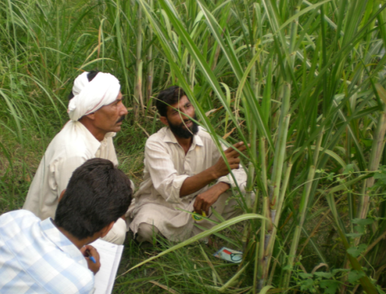
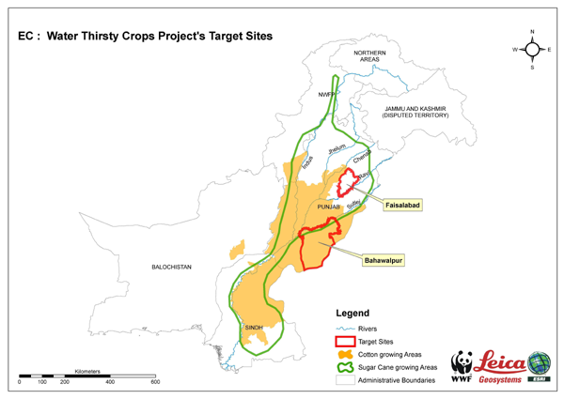
PARTNERING IN PAKISTAN FOR BETTER AGRICULTURE PRACTICES
Focus is on creating water use efficiency and improving water quality in Pakistan
Agriculture uses 90-95% of all water in Pakistan
Results thus far in controlled plots:
25% reduction in N
100% reduction in pesticides
20% reduction in water use

Slide 27
ENGAGING SUPPLIERS
Initiating Conversations Internally
Sharing Information
Identifying Opportunity
Partnering
Setting Goals
Managing + Measuring Results

Slide 28
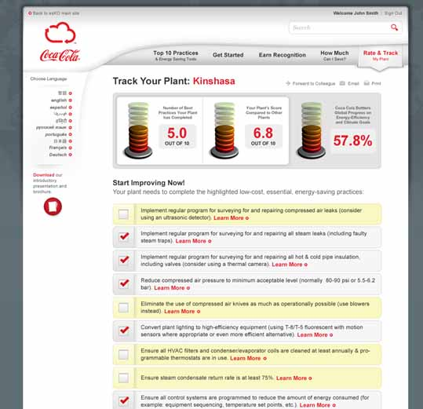
GOALS COME IN ALL SHAPES AND SIZES TOP 10 ENERGY SAVINGS CHALLENGE
JOINT GOAL-SETTING NEEDS TO FIT NEEDS OF ALL PARTIES
The Top 10 goal centered around participation.
Notes:
Coca-Cola employees will have the Carbon Scenario Planner to help identify opportunity and set targets along your supply chain.
This is very good for understanding the opportunity, but once these targets are set, Coca-Cola and bottlers will still need to make this work WITH suppliers. You won’t know the true opportunity until you have conversations with them, understand what they’re doing now, what they have planned, and what they can get done.

Slide 29

CLEAR GOALS: FUEL SAVINGS AND EFFICIENCY
INBEV SHARED LOGISTICS

Slide 30
CHECKLIST: GAUGING OPPORTUNITY
1
SIZE: what is the size of the opportunity for the supplier? For Coca-Cola?
2
CHARACTER: how hard is the change?
3
INVESTMENT: How much will it cost the supplier? Coca-Cola? What resources are needed? ($, staff, etc.) ROI?
4
VIABILITY/RISK: What is the likelihood of success? What big risks are there?
5
SURPRISES: What unexpected consequences might there be? What associated opportunities present upside?
Notes:
Measure emissions throughout the supply chain
Partner with your internal teams in new ways to identify suppliers with greatest climate change impacts.
Make short-term and long-term operational enhancements.
Create incentives for suppliers to reduce their climate change impact.

Slide 31
IDENTIYING OPPORTUNITY FROM INTERNAL PERSPECTIVE
CARBON SCENARIO PLANNER
Notes:
Coca-Cola employees will have the Carbon Scenario Planner to help identify opportunity and set targets along your supply chain.
This is very good for understanding the opportunity, but once these targets are set, Coca-Cola and bottlers will still need to make this work WITH suppliers. You won’t know the true opportunity until you have conversations with them, understand what they’re doing now, what they have planned, and what they can get done.

Slide 32
ENGAGING SUPPLIERS
Initiating Conversations Internally
Sharing Information
Identifying Opportunity
Partnering
Setting Goals
Implementation: Testing, Managing + Measuring Results

Slide 33
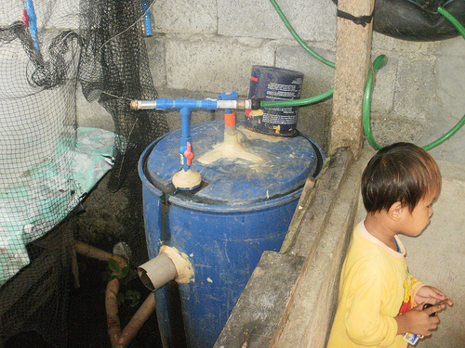
CASE: PARTNERING WITH NGOs
NESTLE + HIVOS METHANE TO POWER, RURAL ENERGY
Biodigesters throughout rural Indonesia turn methane to power for rural dairy farmers.
Notes:
Reaching outside of your sphere of influence sometimes doesn’t look very conventional. Like Nestle and Hivos’ project in rural Indonesia. The problem is one that we know well: Methane gas from farm animals. But Nestle had little capability nor expertise to manage that problem in rural settings.
So Nestle partnered with a development group to tackle that complex problem – of bringing biogas units into rural settings. Nestlé’s Milk Procurement and Dairy Development Department initiated a partnership with an international development organization Humanist Institute for Development Cooperation (HIVOS) to launch two biogas projects in East Java. The first project provided dairy farmers with biogas units to convert methane from their cattle‘s manure into useable energy. (Nestle facilitated access to financial assistance, and HIVOS constructed the biogas units and provided training.) In areas that are too remote for the Nestlé/HIVOS project to reach, like Nestle’s Kejayan factory, Nestlé set up a fund to provide dairy cooperatives with 50 small biogas units and 10 larger units. These renewable energy technologies reduce Nestle’s carbon footprint while providing power for dairy farmers. Nestle’s goal is to set up 8,000 biogas units in total.
Partnering with an international development organization helped Nestle reach into areas it would not otherwise reach; and provided technical and training expertise to make the project successful. While these projects might not have a significant carbon or financial return, they serve as good ways for us to reach into our communities and make the difference that we should.
Remember when we discussed how we might reduce our impact in our citrus groves? Farmer training is one of the answers. Our facilities can explore expert partners at the field level to help us with our initiatives.

Slide 34

SUCCEEDING ACROSS THE SUPPLY CHAIN
Creativity (ideas like shared logistics!)
Communications (new partners! farmer training!)
Not having full control (working with suppliers who are in charge of the decisions!)
Not being an expert (areas beyond your professional experience!)
Notes:
Succeeding along the supply chain means succeeding in areas where we don’t always shine:
Creativity (shared logistics!)
Communications (farmer training!)
Not having full control (working with suppliers who are in charge of the decisions!)
Not being an expert (areas beyond your professional experience!)
It’s an exciting adventure – that will broaden your scope of authority, push you professionally, and bring great value to the company. How can you get started?!

Slide 35
WHAT YOU CAN DO NOW WITH YOUR SUPPLIERS
Share information (Danone, UPS, Procurement team)
Work to measure the opportunity (Wal-Mart/Coke, Tropicana/Earth)
Find common goals/targets (InBev, Cargill/Unilever, WWF + water)
Increase efficiency along the supply chain (Nestle/Hivos)
Notes:
Share information (Danone, UPS)
Work to measure the opportunity (Wal-Mart/Coke, Tropicana/Earth)
Find common goals/targets (InBev, Cargill/Unilever)
Increase efficiency along the supply chain (Nestle/Hivos)
Reduce emissions to be more competitive (Refrigeration)
Coca-Cola and Suppliers
Help Measure (steps)
Help identify opportunities
Help reduce emissions and be more competitive
Supplier and supplier
Exchange information
Exchange resources (trash to treasure)
Increase efficiency within the supply chain
Partnering with Experts and Nonprofits
Exchange information
Exchange resources (trash to treasure)
Increase efficiency within the supply chain

Slide 36
CHECKLIST: ENGAGING SUPPLIERS
1
Initiate conversations internally.
2
Share information with suppliers.
3
Identify and quantify opportunity (with tools, internal teams and experts like nonprofits to find hot spots).
4
Partner with your internal teams to identify suppliers with greatest climate change impacts and those ready to partner.
5
Set goals.
Set common goals and targets that lead to mutual benefit.
6
Manage, create incentives for action for short-term efficiencies and longer-term innovations. Measure.
Notes:
Measure emissions throughout the supply chain
Partner with your internal teams in new ways to identify suppliers with greatest climate change impacts.
Make short-term and long-term operational enhancements.
Create incentives for suppliers to reduce their climate change impact.

Slide 37
FEATURED RESOURCES
Partnering with Suppliers
Sustainability Consortium - http://www.sustainabilityconsortium.org/
Partnering with NGOs
World Wildlife Fund Climate Savers - http://wwf.panda.org/what_we_do/how_we_work/businesses/climate/climate_savers/
Partnering with Development Organizations
Directory of development organizations by region – www.devdir.com
Notes:
These resources help you think about how to partner on climate projects.

Slide 38

CLIMATE AMBASSADORS
CONTACT
BRYAN JACOB
bjacob@coca-cola.com
HIMANSHU JANI
hijani@coca-cola.com
CARLOS PACHECO
capacheco@coca-cola.com

Slide 39
NEXT STEPS ON SETTING TARGETS CARBON SCENARIO PLANNER
Notes:
Closing

